Slide 1
BIOINFORMATICS
An insight into networks
Chiara Cabrelle
Department of Pharmacy and Biotechnology

Slide 2
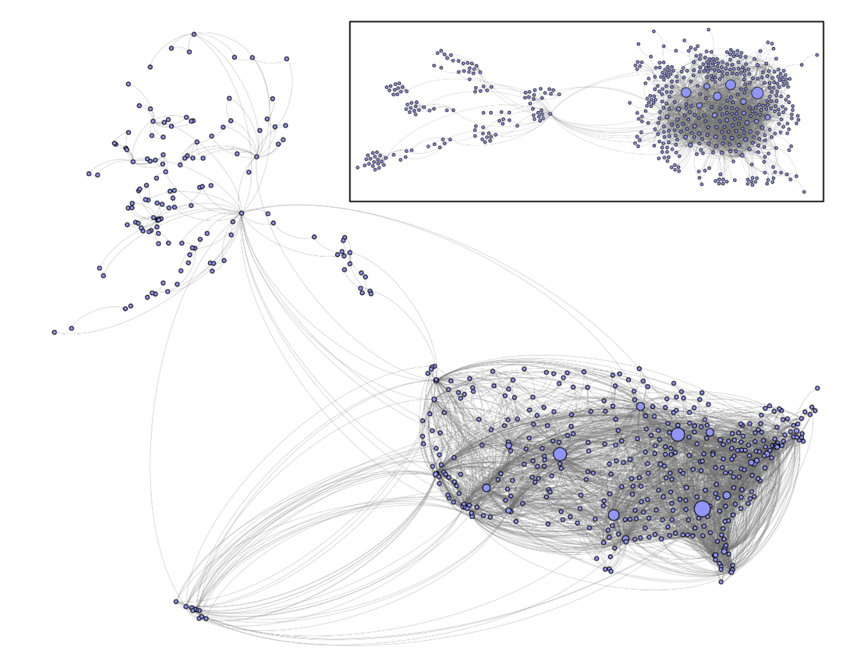
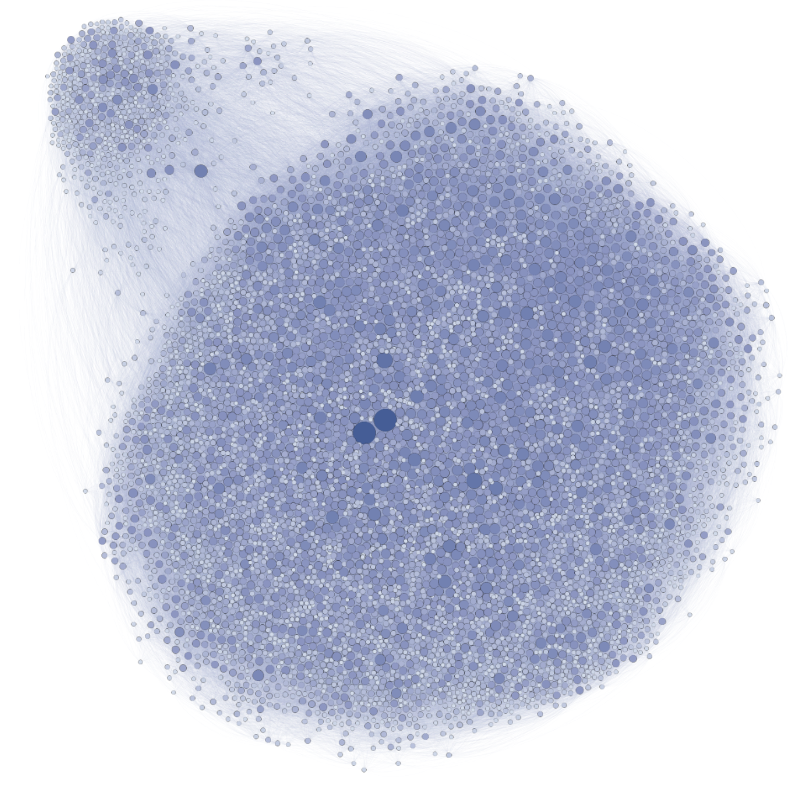
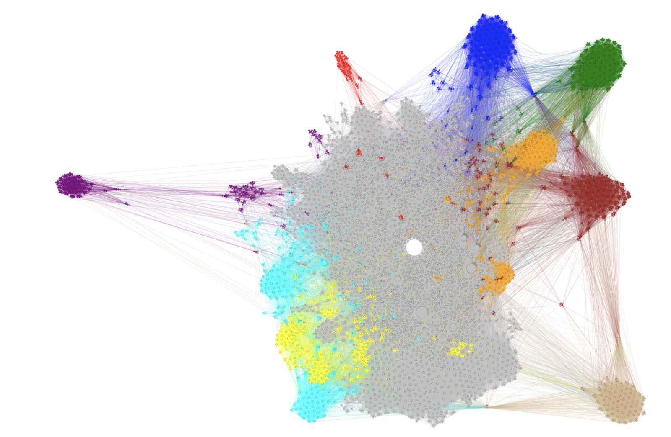
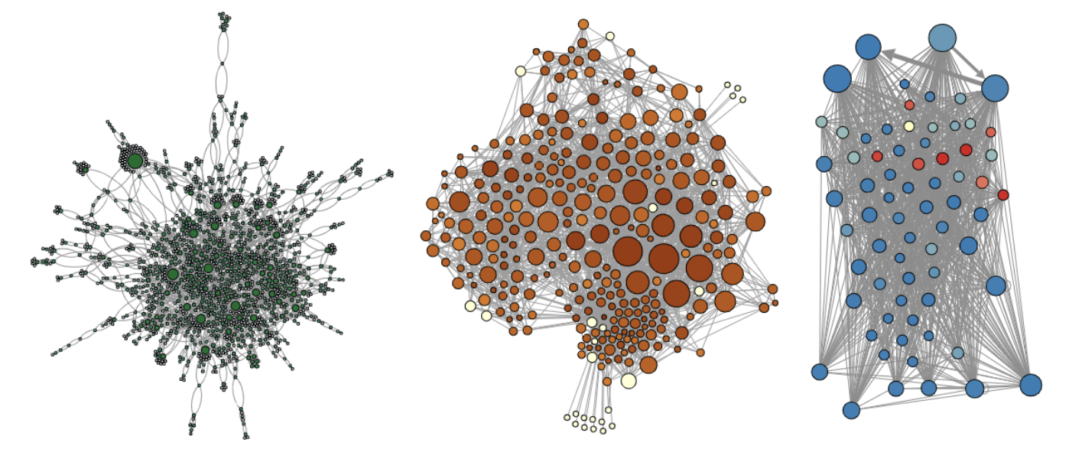

Intro to Networks
Transportation
Networks are everywhere!
Social networks
WWW
Portion of
Wikipedia info
Network
Network of Facebook users
US air transportation network
A First Course in Network Science by F. Menczer, S. Fortunato & C.A. Davis. Cambridge University Press, 2020
Biological networks
Protein interaction network of yeast
Neural network of the Caernorhabditis elegans
Food web of species

Slide 3
Intro to Networks
Network is a theoretical framework allowing to represent real-world complex systems
A network G is a set of N elements called nodes and a set of L pair of nodes called links that represent relationships among the elements
The link (i,j) joins the nodes i and j
Two nodes are adjacent or connected if there is a link between them. Connected nodes are also called neighbors
Node
R
i
j
Link
Terminology
- Network or graph
- Node or vertex
- Link or edge

Slide 4
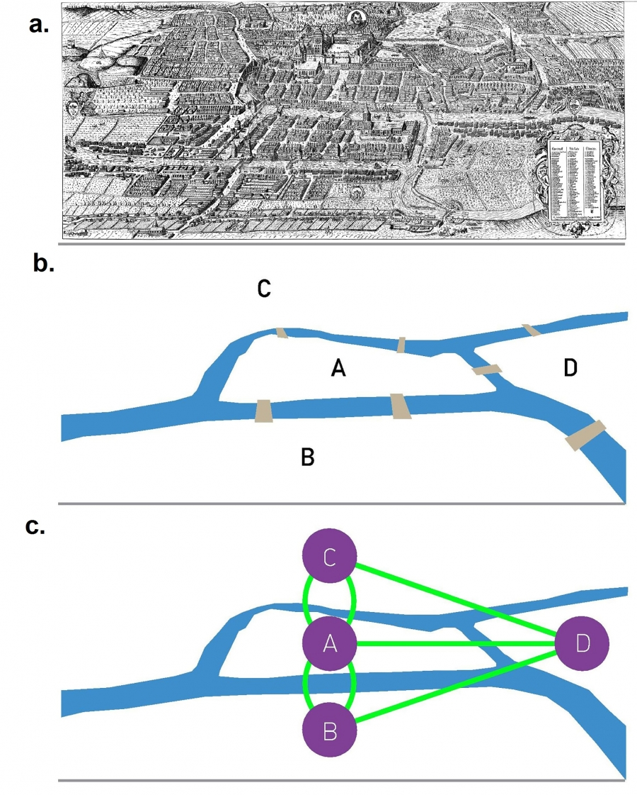
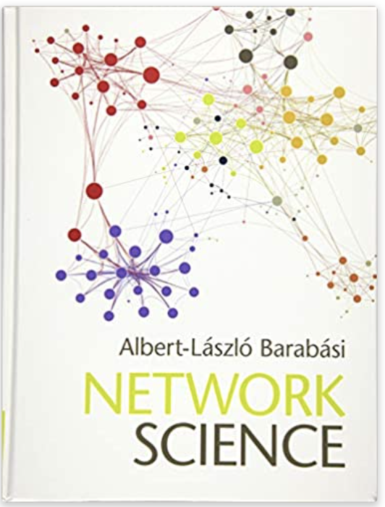
Intro to Networks
The language of networks is found in graph theory
Graph theory can be traced back to the work of Leonhard Euler
Euler’s problem of the Seven Bridges of Königsberg
Is it possible to walk through the city crossing each bridge only once?
There was no Eulerial path in Königsberg
Network Science by Albert-László Barabási
http://networksciencebook.com/ (online version)

Slide 5
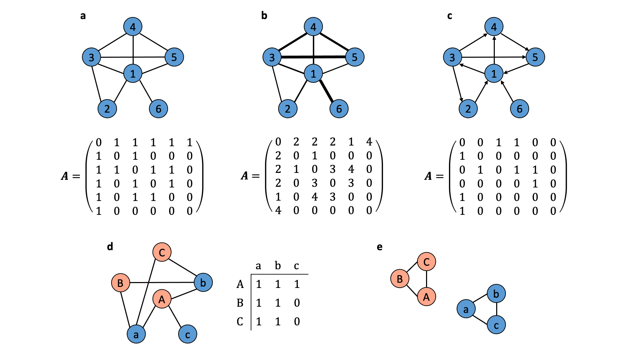
Classes of networks
Undirected networks
bi-directional links
link is an unordered pair of nodes
Directed networks
directed links
link (i,j) goes from the source node i to the target node j
Undirected net
Directed net

Slide 6
Classes of networks
Weighted networks
links with weights
link (i,j,w) between i and j with weight w
Unweighted networks
… Networks can be both directed and weighted network
Unweighted net
Weighted net

Slide 7
Classes of networks
Multiplex networks
multiple types of links
Multipartite networks
multiple types of nodes
Bipartite networks
two groups of nodes such that links only connect nodes from different groups
a projection contains only one type of node that are connected only if they share at least one common neighbor in the bipartite network.
Bipartite network
projections

Slide 8

Networks: from theory to practice
How to manage, analyze and visualize networks?
Open-source software:
Cytoscape (open-source software platform for visualizing complex networks and integrating these with any type of attribute data)
Gephi (visualization and exploration software for all kinds of graphs and networks)
Graphviz (visualization)
Pajek (analysis and visualization of very large networks on Windows), …

Slide 9


Networks: from theory to practice
How to manage, analyze and visualize networks?
Programming libraries:
In R:
igraph:
R connector to the igraph collection of network analysis tools
visNetwork
R package for interactive network visualization
In Python:
networkX
creation, manipulation, and study of the structure, dynamics, and functions of complex networks
Python-igraph
Python connector to the igraph collection

Slide 10


Networks: from theory to practice
Our journey starts in
Open Rstudio!

Slide 11
Let’s install igraph
https://igraph.org/
+
https://igraph.org/r
Download and install the package
install.packages("igraph")
Load package
library(igraph)

Slide 12
Generate a network from scratch
Create an undirected network g
g <- make_empty_graph(5, directed = FALSE)
g #igraph object
plot(g) #plot the network
Add edges to the network g
g <- add_edges(g, edges = c(1,2, 2,3, 2,5, 2,4, 4,5, 1,4, 1,5))
plot(g)
Access nodes and links
#create a node sequence with all nodes of the network
V(g)
#create a node sequence with all nodes of the network
E(g)

Slide 13
Generate networks from scratch
Set node attributes
g <- set_vertex_attr(g, "name", value = LETTERS[1:5]) #or
vertex_attr(g, "name") <- LETTERS[1:5]
Add a node to the network g
g <- add_vertices(g, 1, name=LETTERS[6])
plot(g)
Find nodes adjacent to node 1
neighbors(g, 1)
adjacent_vertices(g, 1)
#querying the adjacent nodes for multiple nodes at once
adjacent_vertices(g, c(1,2))

Slide 14
Generate networks from scratch
Create a weighted network
#by setting edge attributes
g1 <- set_edge_attr(g, "weight", value = c(1,2,2,2,2,5,7))
g1 # weighted network
# check if it is weighted
is.weighted(g1)
Create a directed network
digraph <- make_empty_graph(5, directed = TRUE)
digraph <- add_edges(digraph,
edges = c(1,2, 2,3, 2,5, 2,4, 4,5, 1,4, 1,5))
plot(digraph)
# check if it is directed
is.directed(digraph)

Slide 15
Generate networks from scratch
Create special graphs
Simple star graph
# create a star graph
st <- make_star(20, mode="out", center = 1)
# set node attribute names
V(st)$name <- c("Dumbledore", rep("D.Army",19))
plot(st, vertex.size=10, vertex.color="skyblue")
Erdos-Renyi random graph model
# n is number of nodes, m is the number of edges
er <- sample_gnm(n=100, m=40)
plot(er, vertex.size=6, vertex.label=NA)

Slide 16
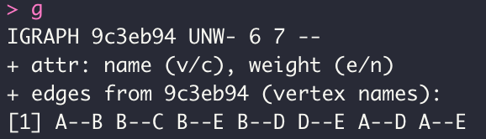
igraph object
FOUR LETTERS:
D or U, for a directed or undirected graph
N for a named graph (nodes attribute "name ")
W for a weighted graph (edges attribute "weight")
B for a bipartite graph (node attribute "type")
TWO NUMBERS:
number of nodes
Number of edges
node and edge ATTRIBUTES:
(g/c) - graph-level/character attribute
(v/c) - vertex-level/character attribute
(e/n) - edge-level/numeric attribute

Slide 17
Generate a network from scratch
Generate a network from a list of links
hp <- graph( c("Harry", "Ron", "Ron", "Hermione", "Ron", "Hermione", "Harry", "Hermione", "Draco", "Piton"),
isolates=c("Raptor", "Voldemort"), directed = F )
# in named graphs, we can specify isolates by providing a list of their names.
plot(hp, vertex.color="skyblue", vertex.size=15, vertex.frame.color="blue", vertex.label.color="black",
vertex.label.cex=0.8, edge.curved=0.2)
V(hp)$name
# automatically generated with graph()

Slide 18
Generate a network from scratch
Add attributes to the network, vertices, or edges:
#List names of vertex attributes
vertex_attr_names(hp)
V(hp)$name
V(hp)$soul <- c("hero", "hero", "hero", "villain", "hero", "villain", "villain")
#List names of links attributes
edge_attr_names(hp) #0
E(hp)$type <- "friendship"
E(hp)$weight <- 10
#Examine attributes
edge_attr(hp)
vertex_attr(hp)

Slide 19
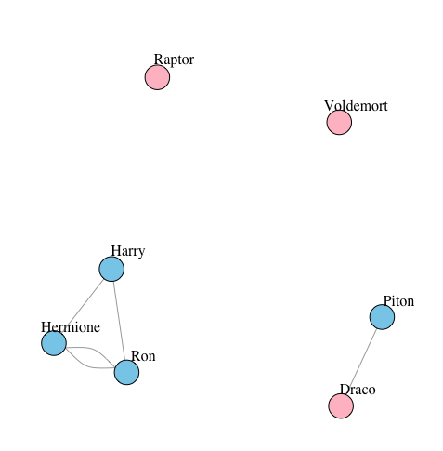
Generate a network from scratch
Plot according to node attribute soul
plot(hp, vertex.label.color="black", vertex.label.dist=2,
vertex.color=
c("pink","skyblue")[1+(V(hp)$soul=="hero")])
Simplify the network
hps <- simplify(hp, remove.multiple = T, edge.attr.comb=c(weight="sum", type="ignore"))
E(hps)$weight
plot(hps, vertex.label.dist=2)
Simple network:
no multiple edges
no self-loops

Slide 20
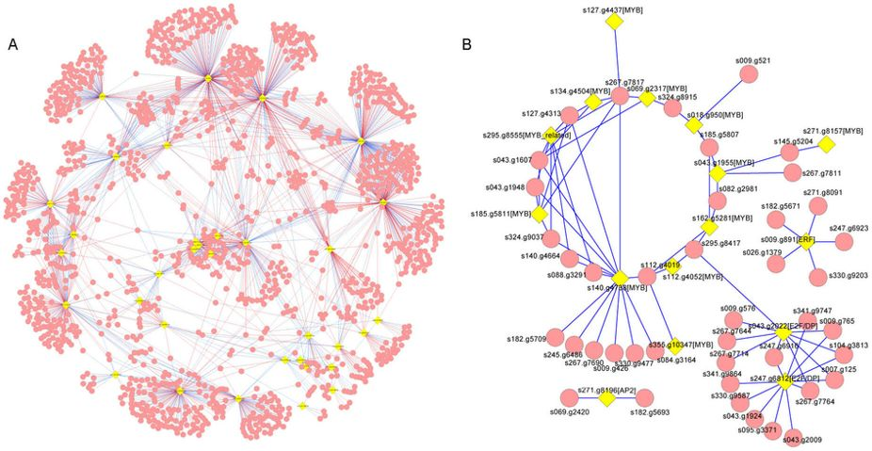

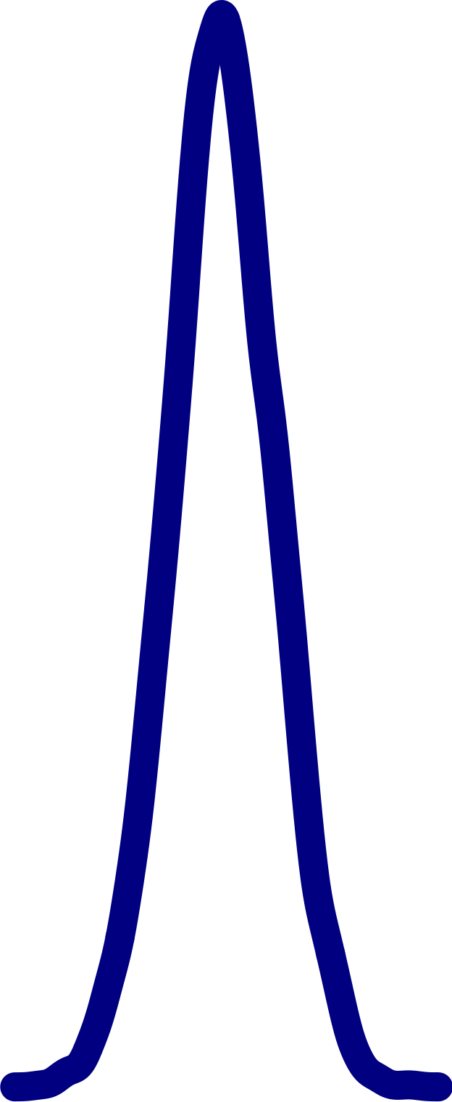

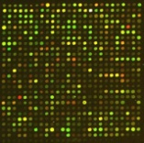
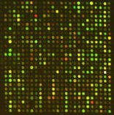
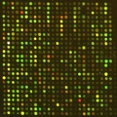
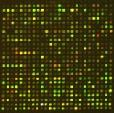

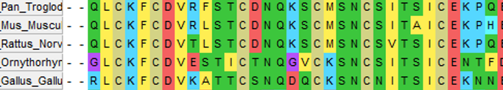
Gene Regulatory Networks
GRNs model the interactions behind transcriptional regulation of gene expression
The purpose of the reverse engineering is to infer the regulation network of the biological system from biological data
Different Reverse-engineering methods: coexpression-based, motif-based, ChiP-Seq-based, orthology-based,...
Coexpression-based GRN by correlation (e.g., Pearson Correlation Coefficient)
Gene Regulatory Network
Data
Network Reverse Engineering

Slide 21
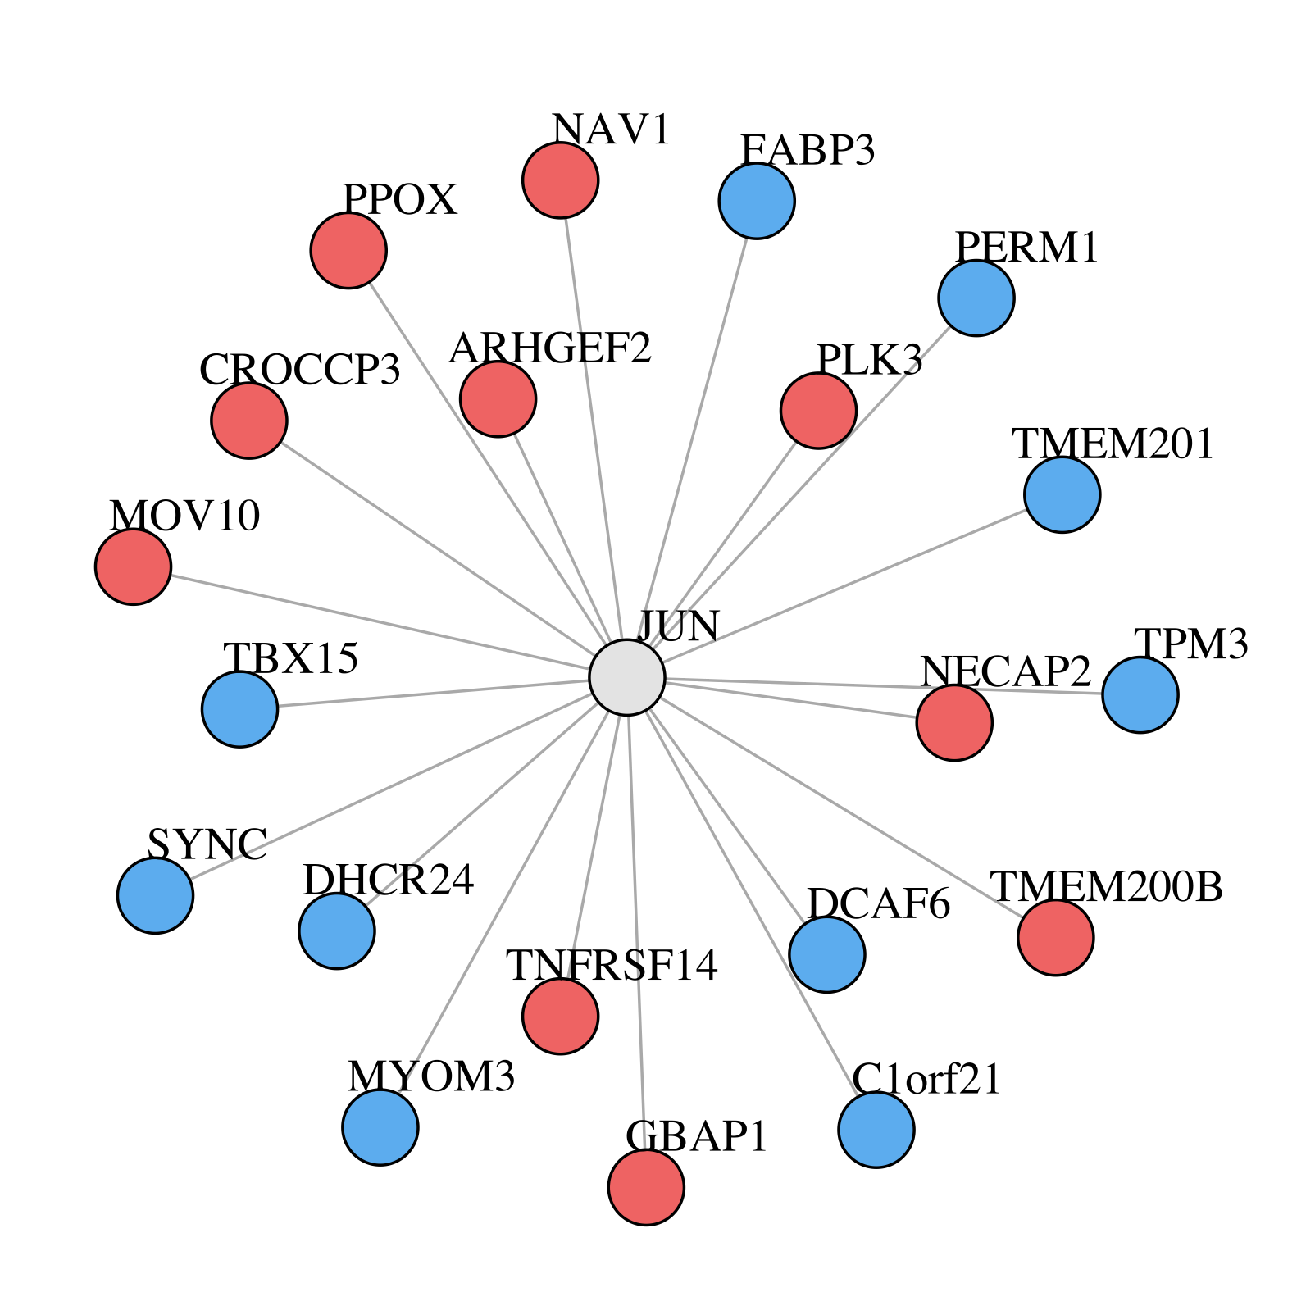
Exercise 1
Built and plot this network from scratch using the genes most correlated with the transcription factor JUN obtained from the gene expression matrix of GTEX Muscle dataset:
https://www.dropbox.com/s/ia16i94z3v3h9x9/genes_corr2JUN.txt?dl=0

Slide 22
Solution
corr_genes <- c("ARHGEF2", "MOV10", "PLK3", "NECAP2", "TNFRSF14", "NAV1", "GBAP1", "PPOX", "CROCCP3", "TMEM200B", "PERM1", "TPM3" , "TBX15" , "TMEM201", "SYNC", "DCAF6", "FABP3", "C1orf21", "MYOM3", "DHCR24")
st <- make_star(21, mode="undirected", center = 1)
V(st)$name <- c("JUN", corr_genes)
plot(st, vertex.size=10, vertex.color=c( "yellow1", rep("indianred2",10), rep("royalblue2",10)), vertex.label.color="black", vertex.label.dist=2)

Slide 23
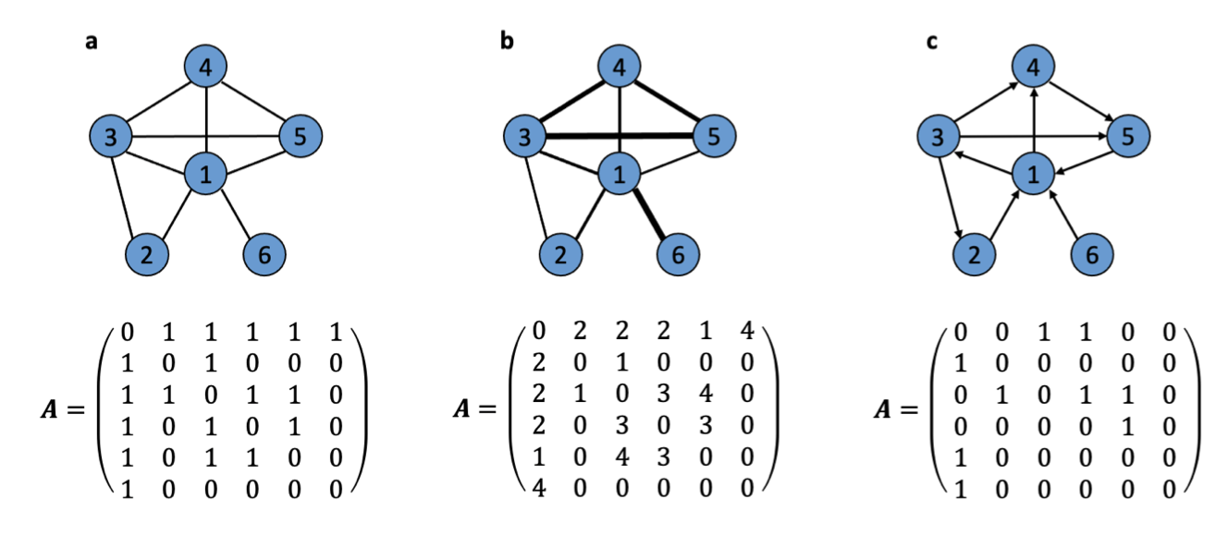
Network representations
Adjacency matrix
N x N matrix in which each element represents the link between the nodes
Element a_{ij} of the adjacency matrix represents the link between nodes i and j.
1 2 3 4 5 6
1 2 3 4 5 6
1 2 3 4 5 6
1
2
3
4
5
6
1
2
3
4
5
6
1
2
3
4
5
6
undirected network
symmetric matrix
weighted network
w_{ij} can take any value for link weight
directed network
non symmetric matrix

Slide 24
Network representations
Adjacency matrix
N x N matrix in which each element represents the link between the nodes
the storage space grows like the square of the network size (N²)
adjacency matrix is not efficient for large and sparse networks
Edge list
lists each link as a pair of connected nodes
for weighted networks, the third column contains weights
Adjacency list
lists neighbors for each node

Slide 25
Network representations
Convert the graph to its adjacency matrix
as_adjacency_matrix(g)
Convert the graph to its adjacency list
as_adj_list(g)
Convert the graph to its edge list
as_edgelist(g)

Slide 26
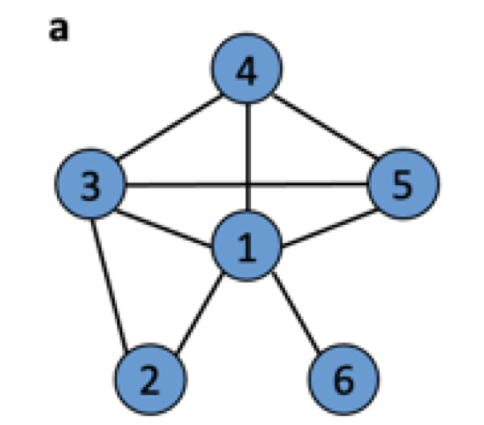
Exercise 2
First part
Reproduce this network
Convert it to its edgelist structure
Second part
Create the adjacency matrix, the edgelist and the adjacency list for the network generated in the Exercise 1
Save the edgelist to a csv file
as.matrix(edgelist)
name the columns as “source” and “target” with the function colnames()
write.csv() → remember ?write.csv()

Slide 27
Solution
First part
#network representations
UN <- graph(edges = c("1","2", "1", "3", "1", "4", "1", "5", "1", "6", "2", "3", "3", "4", "4", "5", "3", "5"), directed = F)
plot(UN)
edgelist_UN <- as_edgelist(UN)
Second part
JUN_adjmat <- as_adjacency_matrix(st)
JUN_adjlist <- as_adj_list(st)
JUN_edgelist <- as_edgelist(st)
JUN_mat <- as.matrix(JUN_edgelist)
#rownames(JUN_mat) <- seq_len(nrow(JUN_mat))
colnames(JUN_mat) <- c("source","target")
write.csv(JUN_mat, "JUN_edgelist.csv")

Slide 28
Network analysis
Global properties
the total number of nodes
the total number of links
the edge density
…
Local properties
clustering coefficient
centrality measures:
node degree
betweennes
…
To identify hubs, to study network structure and function (e.g., the robustness of the network)…

Slide 29
Network analysis – Global properties
The order of graph = Number of nodes (N)
vcount(UN)
#or
gorder(UN)
The size of the graph = number of links (L)
ecount(UN)
#or
gsize(UN)

Slide 30
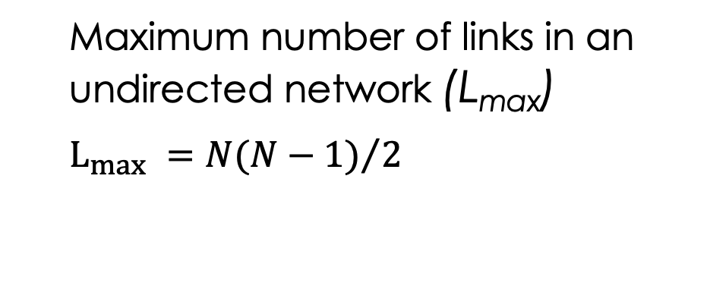
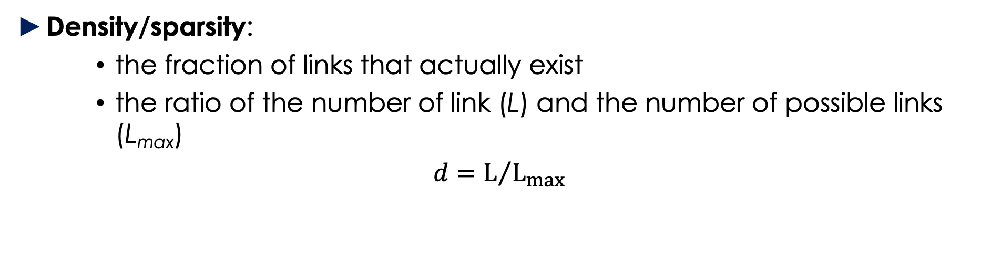
Network analysis – Global properties
Density/sparsity:
the fraction of links that actually exist
the ratio of the number of link (L) and the number of possible links (L_{max})
$d=L/{L_{max}}$
edge_density(g) # for graph without self-loops
Real network are sparse!
The complete graph has the maximum number of links, so it has the maximum density that equals one.
#generate a full graph
complete_net <- make_full_graph(10)
edge_density(complete_net) #1
Maximum number of links in an undirected network (L_{max})
$L_{max} ={N(N−1)}/2$

Slide 31
Network analysis – Local properties
Node degree:
The degree k_{i} of the node i is the number of links connecting it to its neighbors
# node degree for node i=1 of network UN
degree(UN, 1)
# node degree for each node
degree(UN)
Which node has the highest degree?

Slide 32
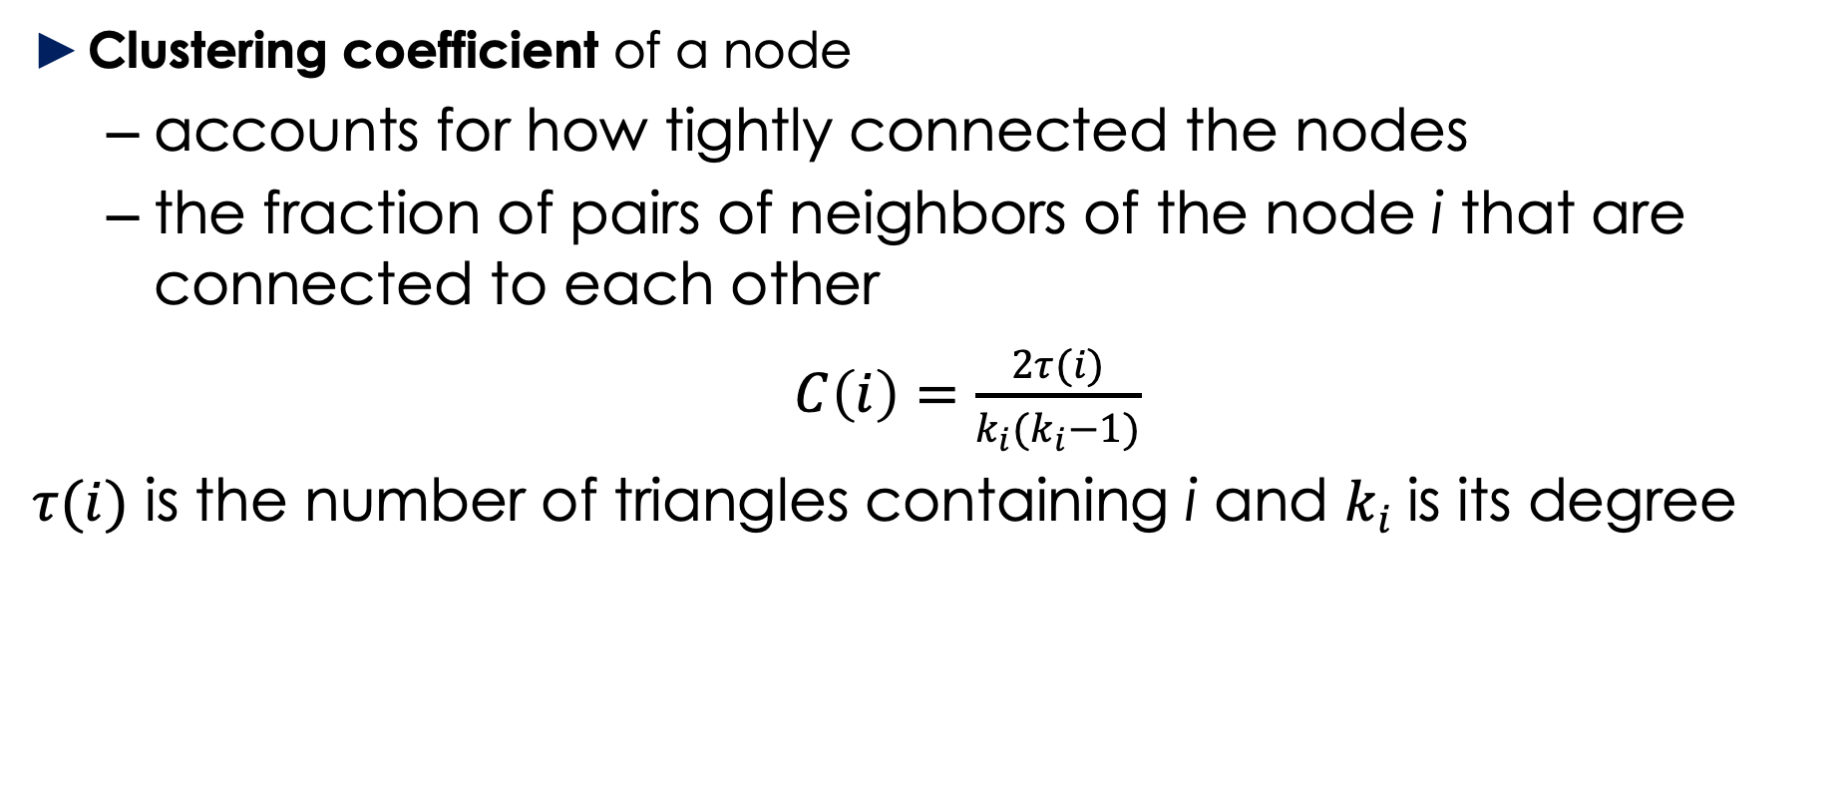
Network analysis – Local properties
Clustering coefficient of a node
accounts for how tightly connected the nodes
the fraction of pairs of neighbors of the node i that are connected to each other
$C\left(i\right)=\frac{2τ(i)}{k_{i}(k_{i}−1)}$
$τ(i)$ is the number of triangles containing i and $k_{i}$is its degree

Slide 33
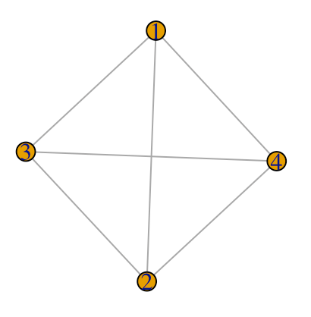
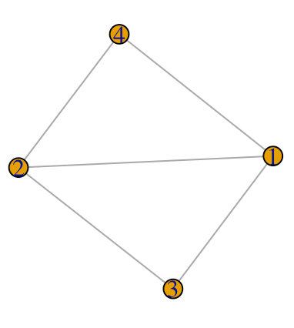
Network analysis – Local properties
Clustering coefficient of a node
# clustering coefficient for each node
g <- graph(edges= c(1,2,1,3,1,4,2,3,2,4,3,4), directed = F)
plot(g)
transitivity(g, type = "local", vids = V(g))
g1 <- graph(edges= c(1,2,1,3,1,4,2,3,2,4), directed = F)
plot(g1)
transitivity(g1, type = "local", vids = V(g1))

Slide 34

Let’s install Cytoscape
You can install it for free here:
https://cytoscape.org/download.html

Slide 35
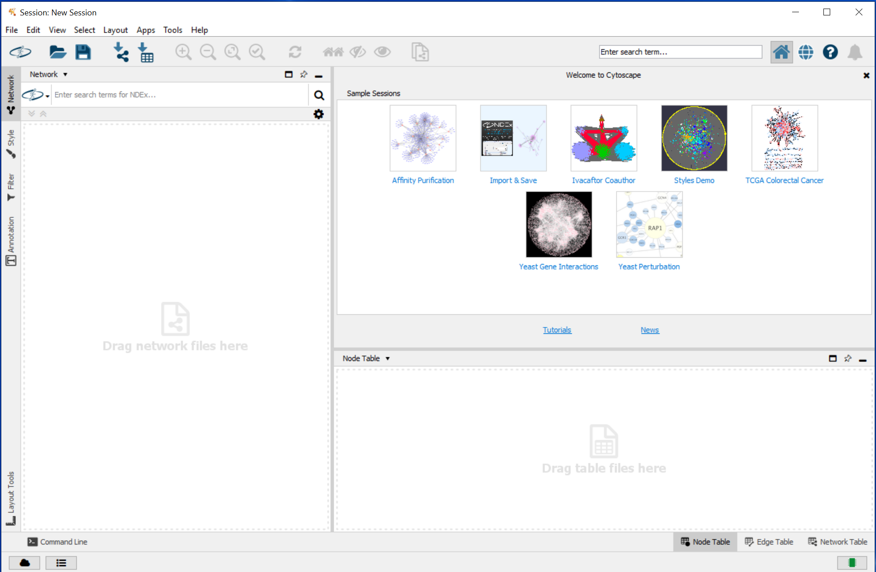
Let’s install Cytoscape
Click, click… to install
Open Cytoscape!

Slide 36
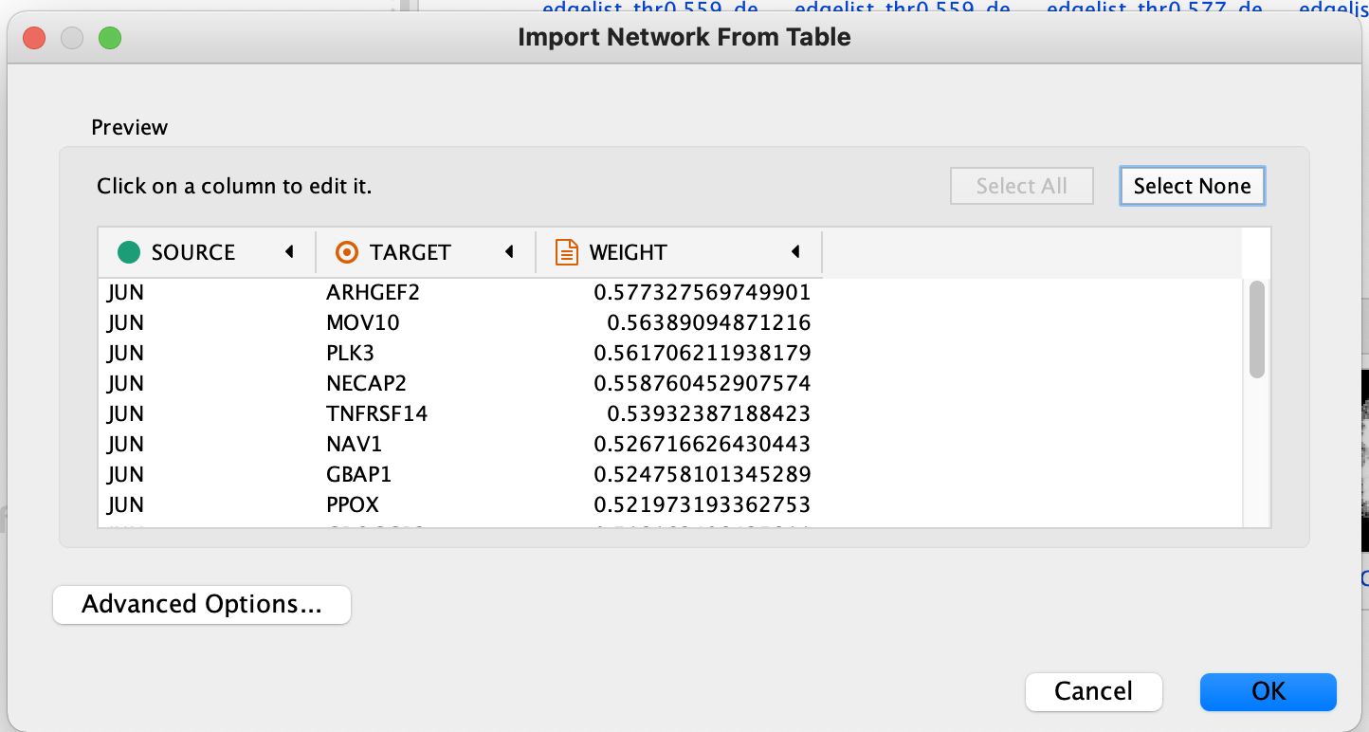
Network visualization
Download the file:
https://www.dropbox.com/s/e0wgwy2ltxj854o/networkJUN.csv?dl=0
Import it on Cytoscape: File -> Import -> Network from file ->
Click and correct the columns:
First col -> Source Node
Second col -> Target Node
Third col -> Target Node Attribute

Slide 37
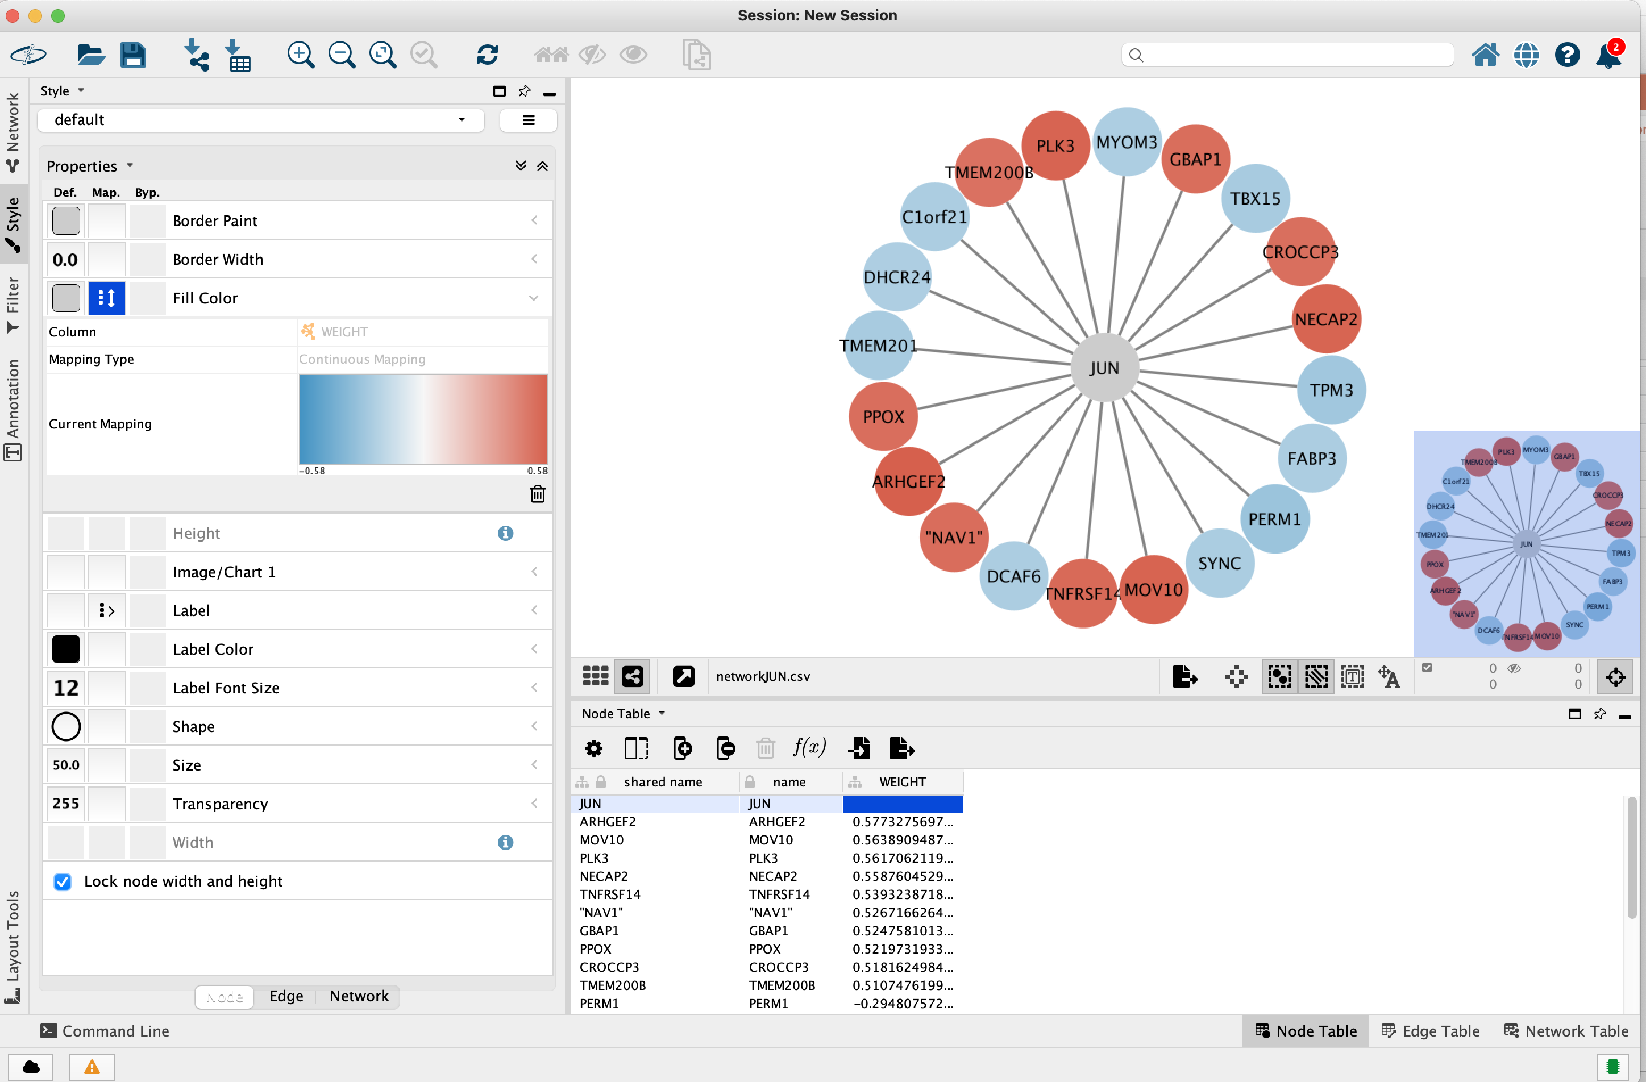
JUN network
visualization

Slide 38
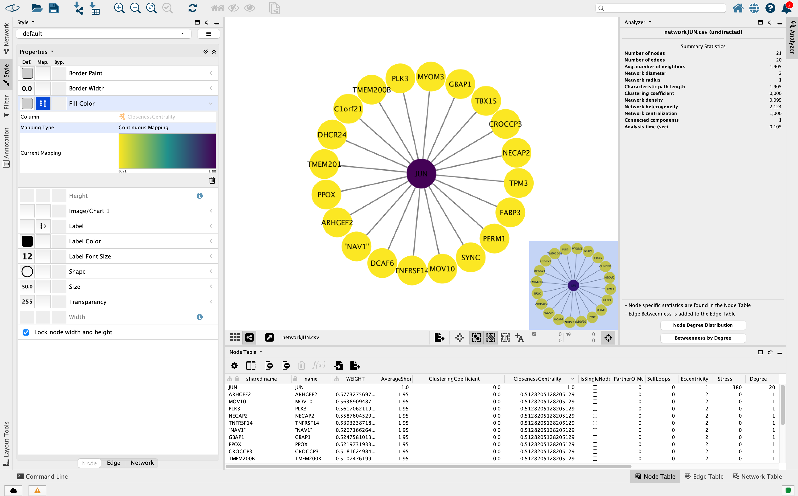
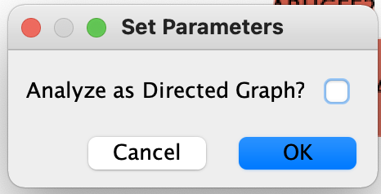
Tools -> Analyze Network ->
Change the style of the network according to different network properties!

Slide 39
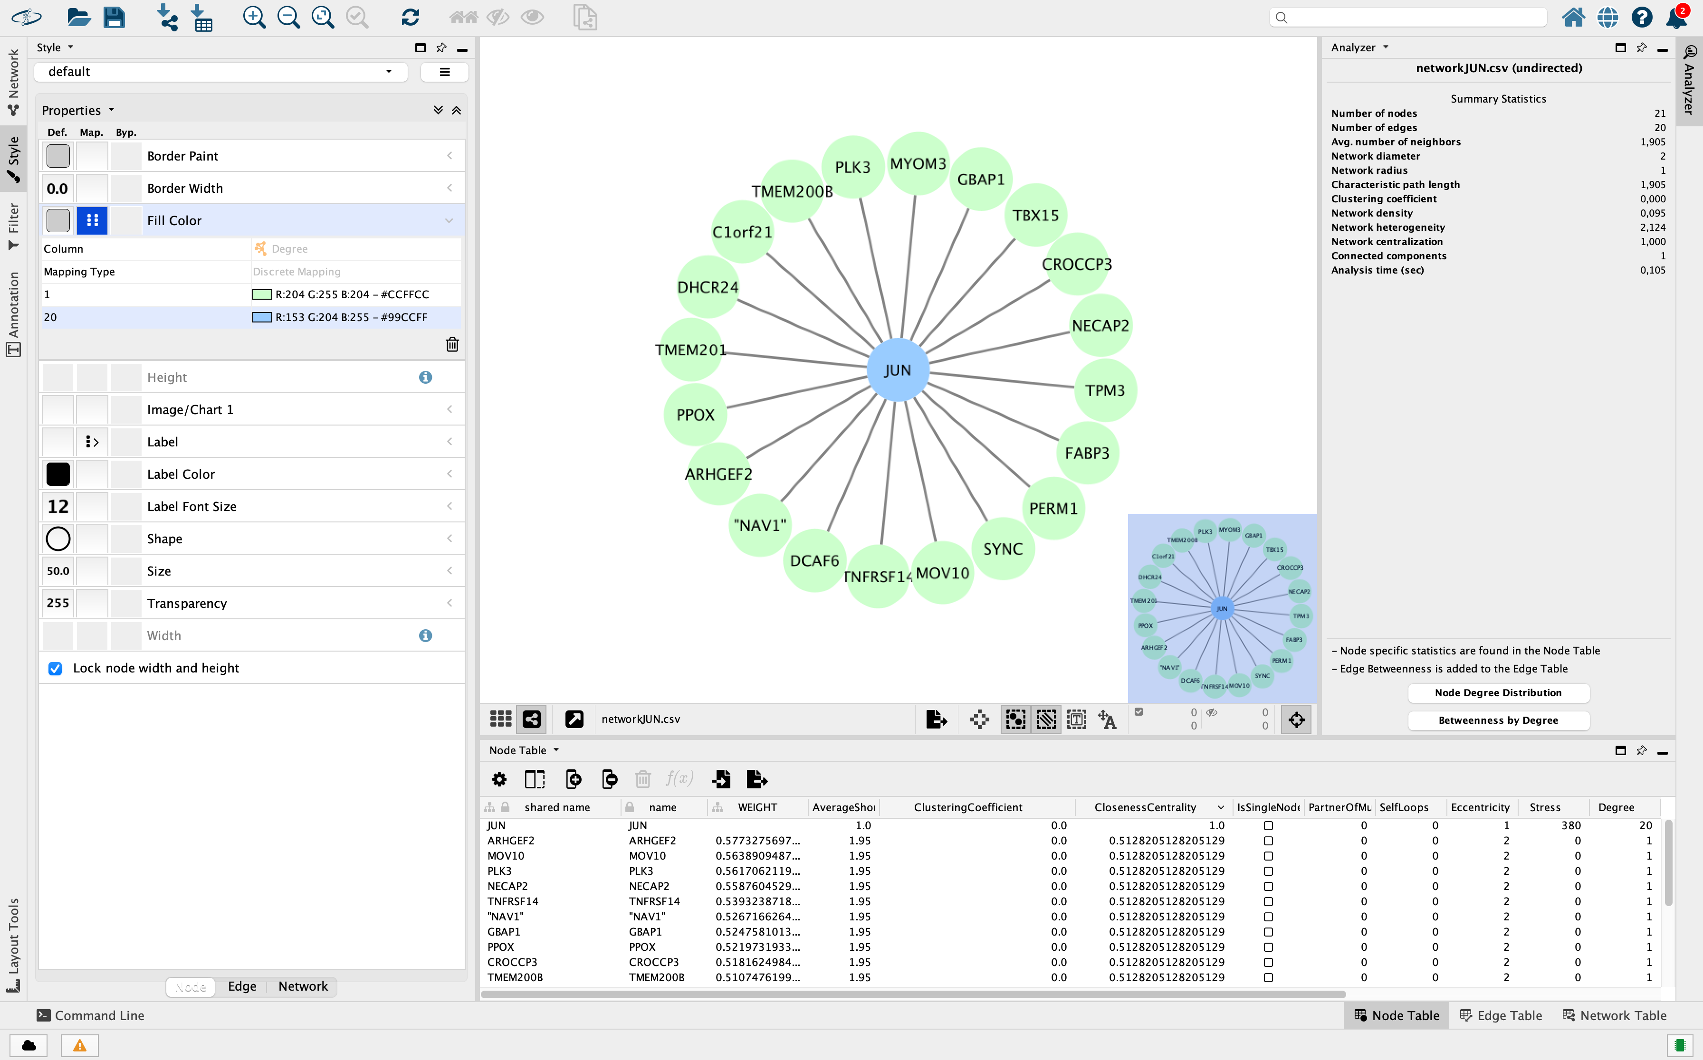
JUN network analysis in Cytoscape
Node Degrees

Slide 40
Mistery Dataset….
Download https://www.dropbox.com/s/rkdu00i3h4m7f3u/HPedgeList.csv?dl=0
Open a new Cytoscape session
Import the file using the default columns
Download
https://www.dropbox.com/s/yd59145n09vox64/HPnodeList.csv?dl=0
Import -> Table from file

Slide 41
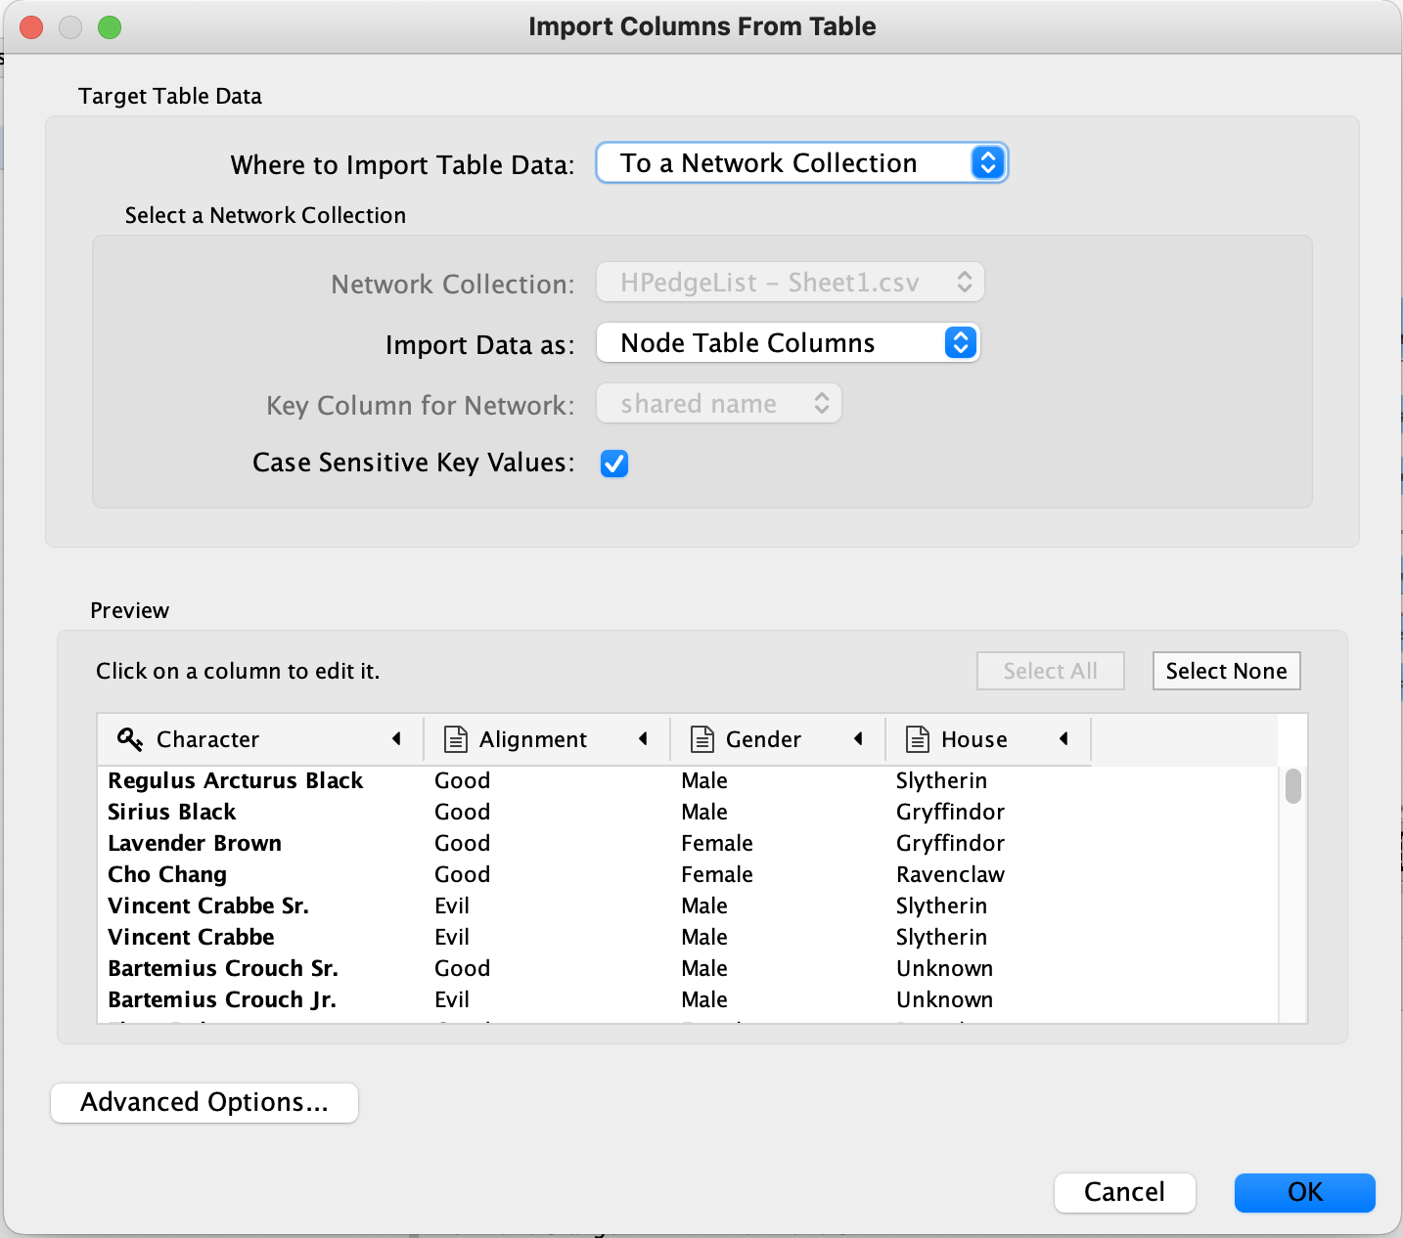
Mistery Dataset….
Download
https://www.dropbox.com/s/yd59145n09vox64/HPnodeList.csv?dl=0
Import -> Table from file ->

Slide 42
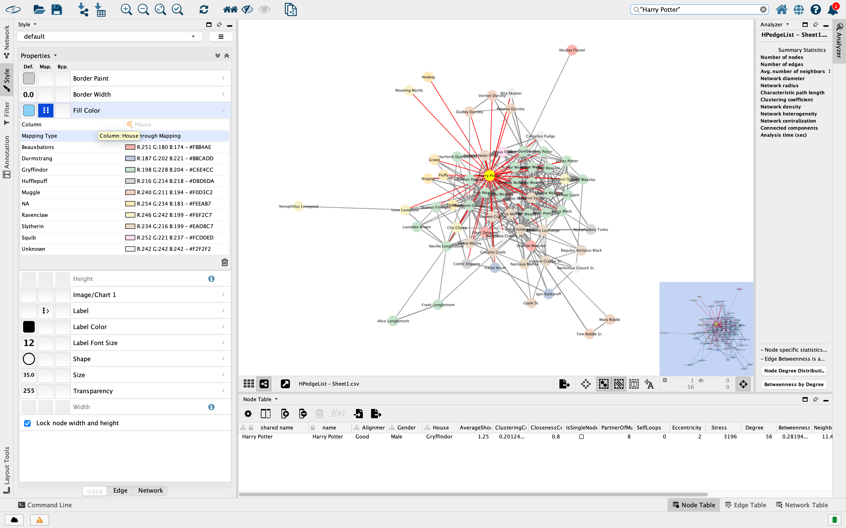
Mistery Dataset….

Slide 43
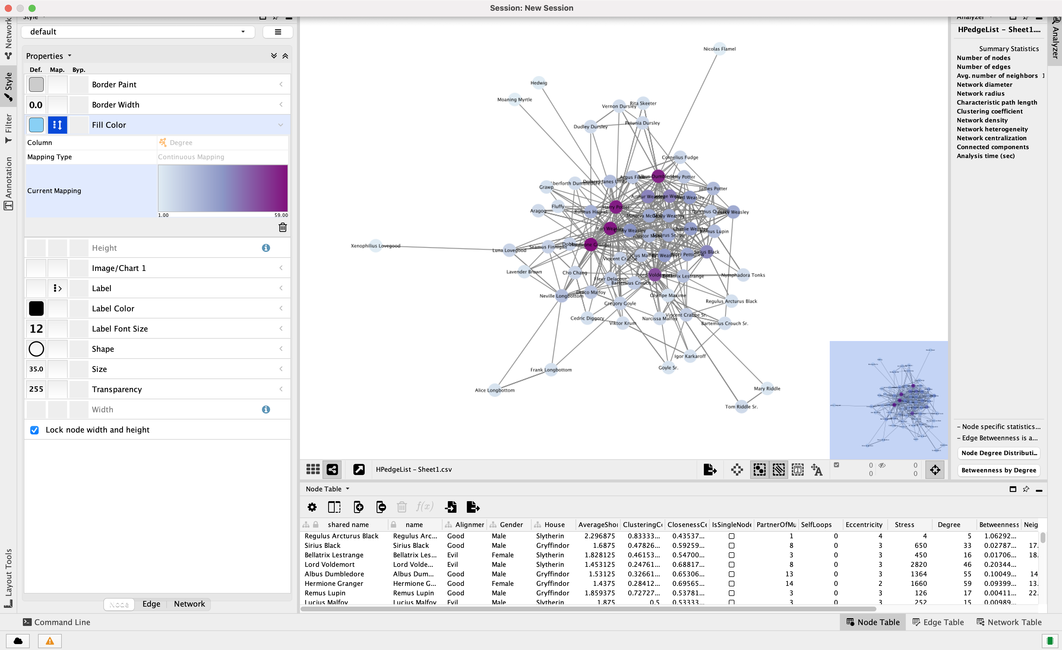
Mistery Dataset….

Slide 44
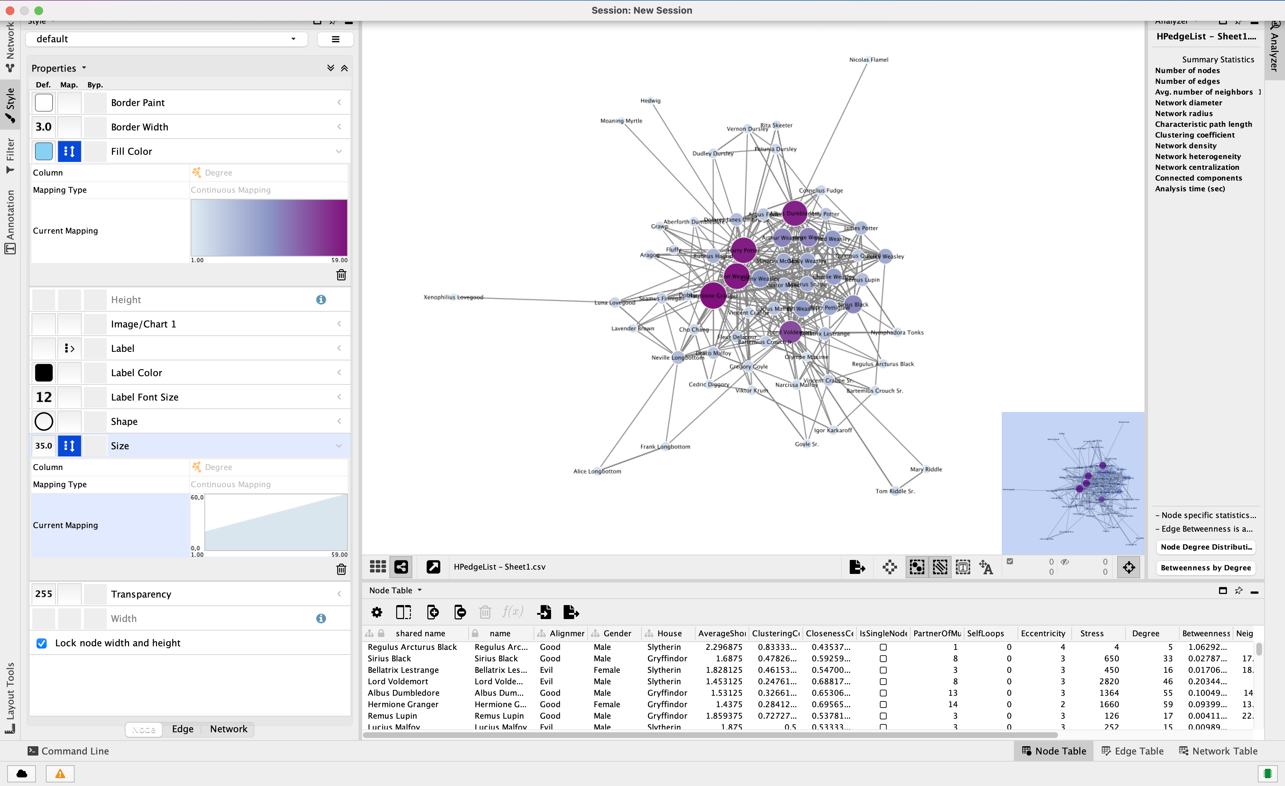

Slide 45
2. Drug-target networks

Slide 46

DrugBank
https://go.drugbank.com/
Freely available drug database that includes primarily drugs and drug targets information
Curated resource of cheminformatics and bioinformatics data
Data about drugs: chemical structures and physical properties, mechanisms of action and pharmacological profiles
Data about drug targets: sequences, structures and mechanistic data

Slide 47
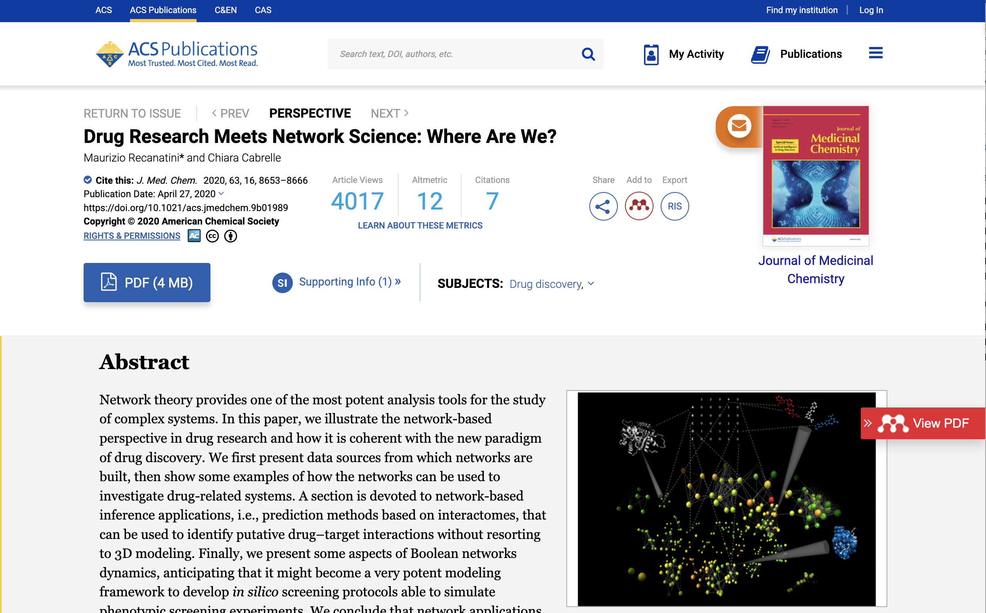
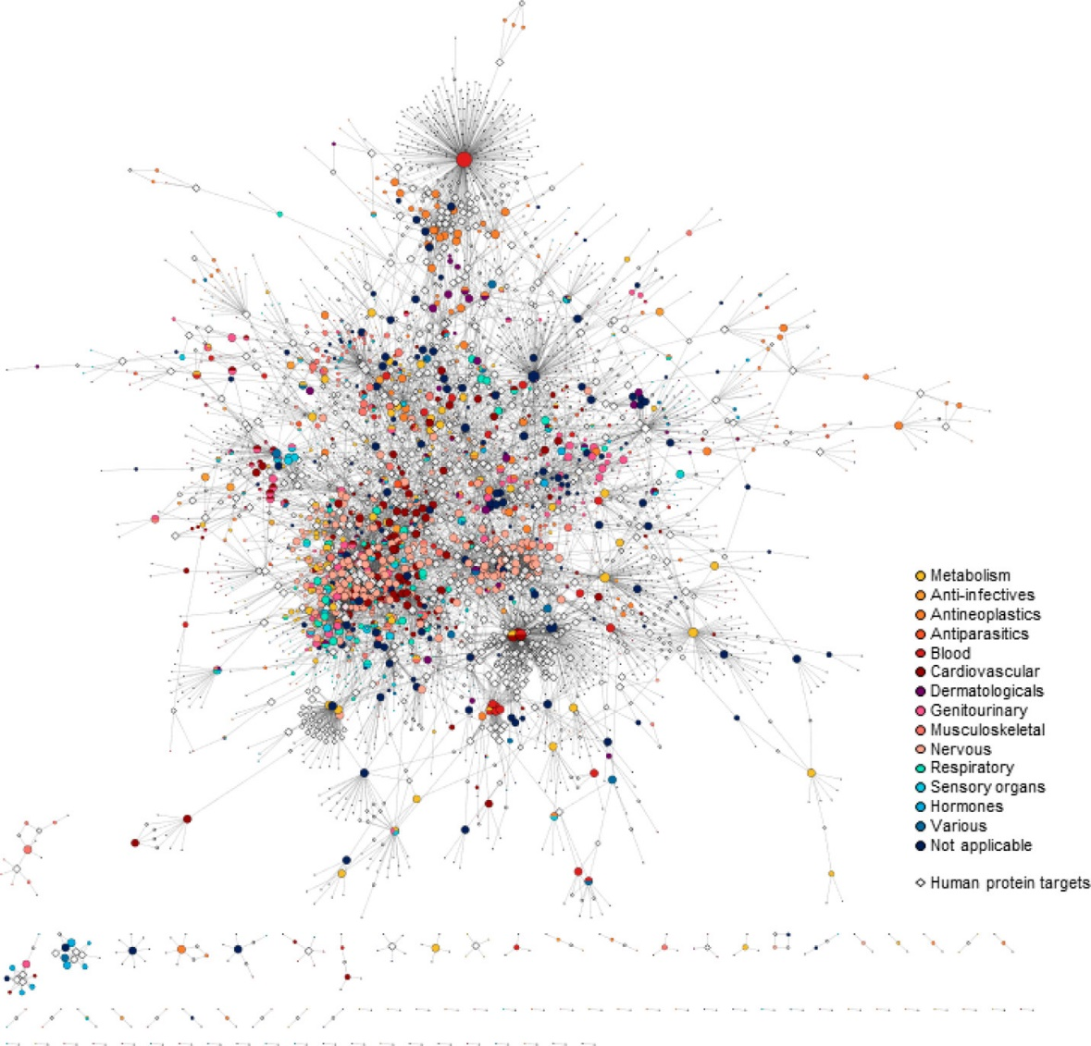
Drug-target network from Drugbank
Drug-target networks (DTNs) have been proposed as bipartite graphs that model drug-target interaction

Slide 48
Drug-target network from Drugbank
DTN of approved drugs (small molecules) and human protein targets
The network contains 3627 nodes, 1636 of which represents drugs, and links represents 7521 drug-target interactions
The drugs are colored according to the first level of the anatomical therapeutic chemical (ATC) code
What is the ATC code?
https://www.whocc.no/atc/structure_and_principles/

Slide 49
Chiara Cabrelle
Dept of Pharmacy and Biotechnology
chiara.cabrelle2@unibo.it

Slide 50
An insight into a TF network
Real World scenario: GTEX Muscle gene expression dataset
- From the gene expression matrix (expmat), we find the gene most correlated with the transcription factor JUN”
# Read the matrix using the link to the csv file
expmat<-as.matrix(read.csv("https://www.dropbox.com/s/zq41spcotkurgsr/gtex_Muscle-tpms.csv?dl=1",row.names=1))
# Loop over the matrix
allcors<-c()
for(i in rownames(expmat)){
c<-cor(expmat[i,],expmat["JUN",])
allcors<-c(allcors,c)
}
names(allcors)<-rownames(expmat)
# most positively correlated genes
sort(allcors,decreasing=TRUE)[1:10]
cor() function to calculate Pearson correlation coefficient between JUN and gene i

Slide 51
Gene Regulatory Networks
In a GRN,
nodes represent genes, both coding and noncoding or regulatory elements…
edges represent various regulatory connections (activation, repression, modulation, et cetera) and they can be weighted to describe the strength of the regulatory relationship

